Slide 1



4. HUMAN-COMPUTER INTERACTION
D. Serikbayev East Kazakhstan State Technical University
ICT Spring 2019
Notes:
Watch on YouTube: https://youtu.be/gWFzk0RuUpw
Welcome to this series! In the next several videos, we explore the basics of HCI, which is human-computer interaction.

Slide 2

Copyright Notice
This presentation is presented as is. This presentation was assembled using information from various websites or sources across the web.
This presentation uses Creative Commons Attribution 4.0 International (CC BY 4.0). © 2019 BilimEdtech

Slide 3
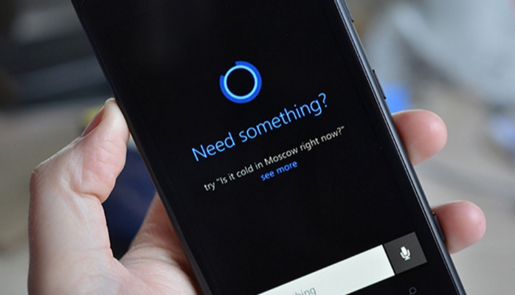
4.1: Introduction to HCI
4.1: Introduction to HCI
4.2: HCI Goals
4.3: HCI User Experiences
Notes:
During part one of this three-part series, we introduce the topic of HCI.

Slide 4
Objectives
Describe the three parts of HCI
Understand the goals of HCI
State the HCI golden rule
Recall the three disciplines of HCI
List examples of HCI
Notes:
Please take a moment to read the learning objectives for this video.

Slide 5
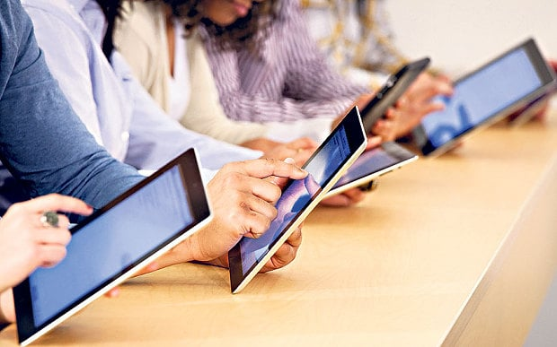
Introduction: Technology is Essential
Interacting with technology has become an essential part of everyday life for the majority of people
Notes:
In today’s world, interacting with technology has become an essential part of everyday life for the majority of people. We use it for communication, work, entertainment, making purchases, and financial transactions. Engineers create computer systems to solve important problems in our societies. Or, these systems replace human labor. For example, you might visit an ATM instead of talking to a teller at the bank.

Slide 6
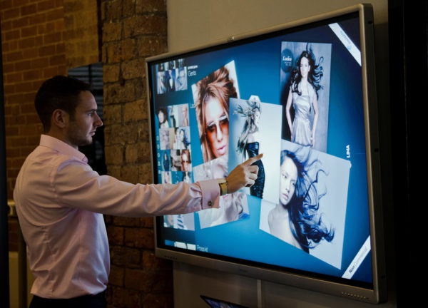
Introduction (2): Use without Understanding
Many computer system users do not need to understand the technology that they use
The user only needs to know how to operate and interact with the system
Notes:
Technology is so pervasive that we use it without understanding how the technology works, or even that we are using a computer system.
We only need to know how to operate and interact with the system.
For example, when you add credits to your mobile phone, you probably do not think about the process of how that system works.
Instead, you follow the prompts on the pay terminal, add some money, and then receive a message saying that credits have been added to your phone.

Slide 7

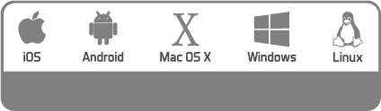
Introduction (3): Different Technologies
There are different types of technology that we all use
  Computers: Laptops, smartphones
Notes:
There are many different types of technology that we all use. The common examples are personal devices, such as a laptop or smartphone. However, there are many hardware brands and operating systems.
For example, someone might have a Lenovo laptop that runs Windows or a Samsung phone that runs Android.
Another class of ubiquitous technologies is terminals that we use to pay bills, purchase a metro or bus ticket, or get money from an ATM.

Slide 8
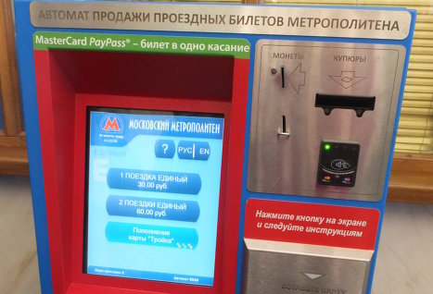
Introduction (3): Different Technologies
There are different types of technology that we all use
  Computers: Laptops, smartphones
  Terminals: Metro tickets, ATMs, pay bills
Notes:
Another class of ubiquitous technologies is terminals that we use to pay bills, purchase a metro or bus ticket, or get money from an ATM.

Slide 9

Introduction (4): Intuitive
Computer systems should be intuitive
  Easy to learn
  Easy to use
Computer systems should be error free
Notes:
Since there are many different systems that we use everyday
These computer systems should be intuitive, meaning they should be easy to learn and easy to use.
They should also be error free.
You should be able to walk up to a terminal and accomplish your task with minimal effort.

Slide 10

HCI Development Goals
The major objectives of HCI is to develop computer systems interfaces that are:
  Easy to learn
  Easy to use
  Error free
Notes:
The primary objectives of HCI are to develop computer systems interfaces that are easy to learn, easy to use, and error free.

Slide 11
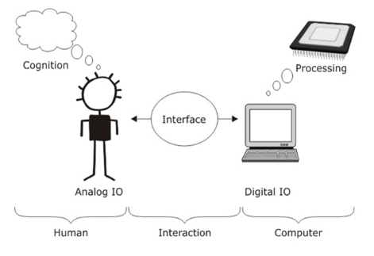
What is HCI?
HCI studies the
interaction between
people (users) and
computers
Notes:
So then, what is HCI? HCI studies the interaction between people (users) and computers.

Slide 12
What is HCI? (2)
HCI consists of three parts:
  Human: an individual user or a group of users
  Computer: mobile device, desktop, terminal, or other device that processes data
  Interaction: any direct or indirect communication between a human and computer
In HCI, interaction takes place at a user interface
Notes:
HCI consists of three parts, which are human, computer, and interaction.
A human is an individual user or a group of users.
A computer is a mobile device, desktop, terminal, or another device that processes data.
Interaction is any direct or indirect communication between a human and computer.
In HCI, interaction takes places at a user interface.

Slide 13
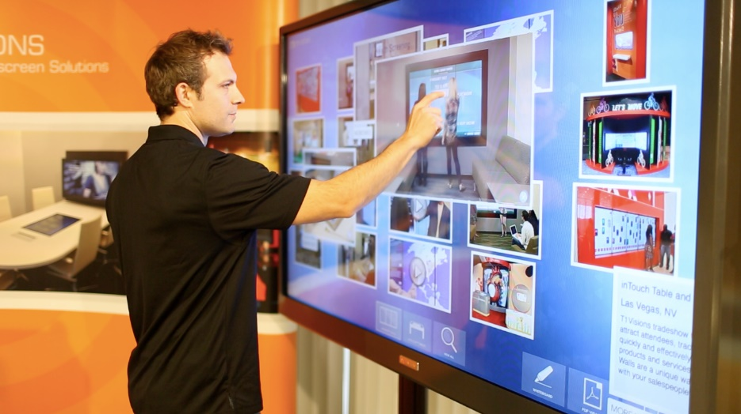
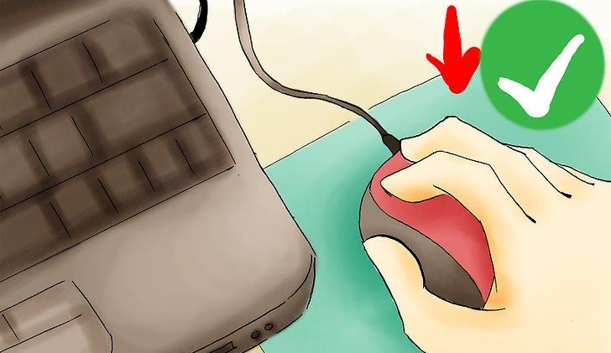
Different User Interfaces
Touch
Mouse
Notes:
A user interface is how a user interacts with or uses a system.
In these two examples, one is using a touchscreen and the other is using a mouse to interact with the system.
Both users are interacting with the graphical user interface on the computer, but they are using different methods.
Consequently, a user interface designed for touch and one designed for a mouse pointer are different.
Fingers are bulky and less accurate, whereas a mouse is precise.

Slide 14
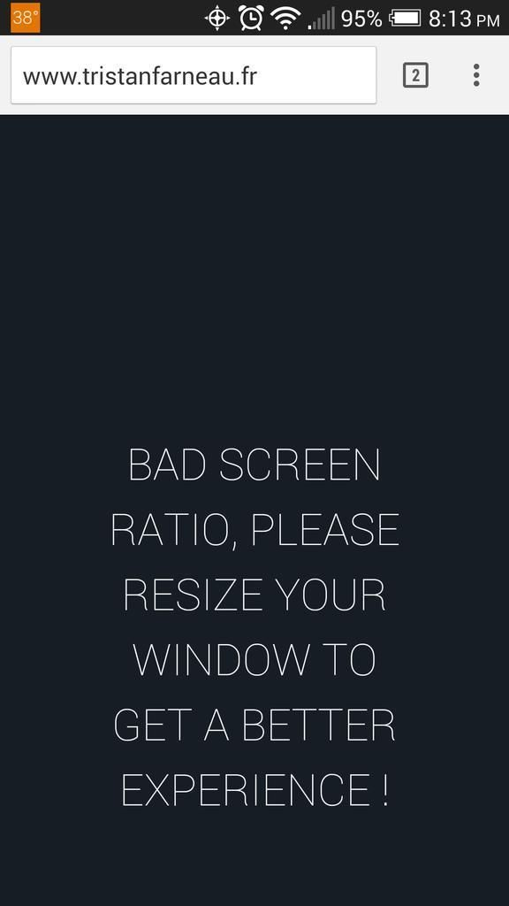
What is HCI? (3)
The golden rule in HCI is that people should come first
What is the purpose of the computer system?
  To help a user accomplish a task
Notes:
The golden rule in HCI is that people should come first.
Since computers are designed to help people, HCI focuses on improving how humans use computers to accomplish a task.
People shouldn’t have to change to use a computer. Instead, systems should be built and adapt to how humans perform work.
This picture is a negative example.
The developer of this website wants a user to access the system on the developer’s terms, not how a user might want to access the system.

Slide 15
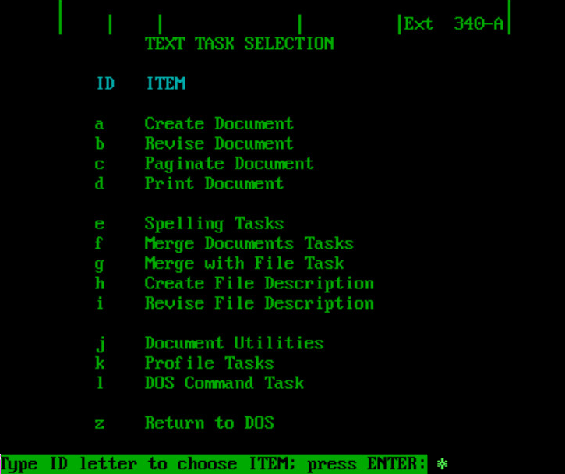
Evolution of User Interfaces
Command line word processing
Notes:
To better understand user interfaces (UIs) or graphical user interfaces (GUIs), it is helpful to look at their history. During the early years of electronic computing, computers did not have capabilities for graphics, but only to display text. Users had a single option of interacting with the computer.

Slide 16
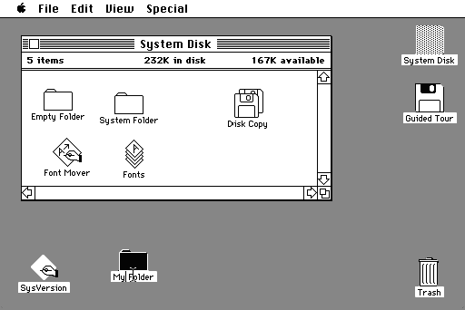
Evolution of User Interfaces (2)
Command line word processing
  Early GUIs
  Macintosh Finder
Notes:
Developers then created rudimentary GUIs that allowed a user to interact with the system in different ways, such as using a mouse to open files in Macintosh Finder.

Slide 17
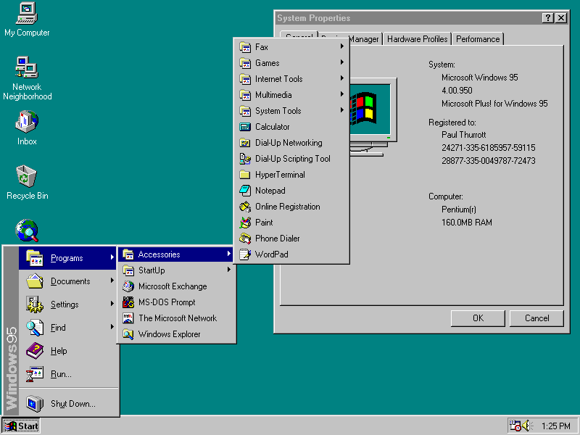
Evolution of User Interfaces (3)
Command line word processing
Early GUIs
  Macintosh Finder
  Windows 95
Notes:
Developers then created rudimentary GUIs that allowed a user to interact with the system in different ways, such as using a mouse to open files in Macintosh Finder.
Since those early days, developers have been improving system interaction, such as the application menu that Microsoft introduced in Windows 95.

Slide 18
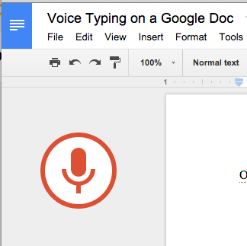
Evolution of User Interfaces (4)
Modern day
  Mouse: Desktop, laptop
  Touch: Laptop, mobile
  Voice: All
  Gesture: Mobile
The Future
  Thought Computing?
Notes:
Today, there are various types of ways that users can interact with a system.
These include using a mouse on a laptop, a touchscreen on a tablet or smart TV, voice commands or voice-to-text, or gestures when playing a game on a smartphone.
In the future, one might be able to interface with a system only using thought.

Slide 19
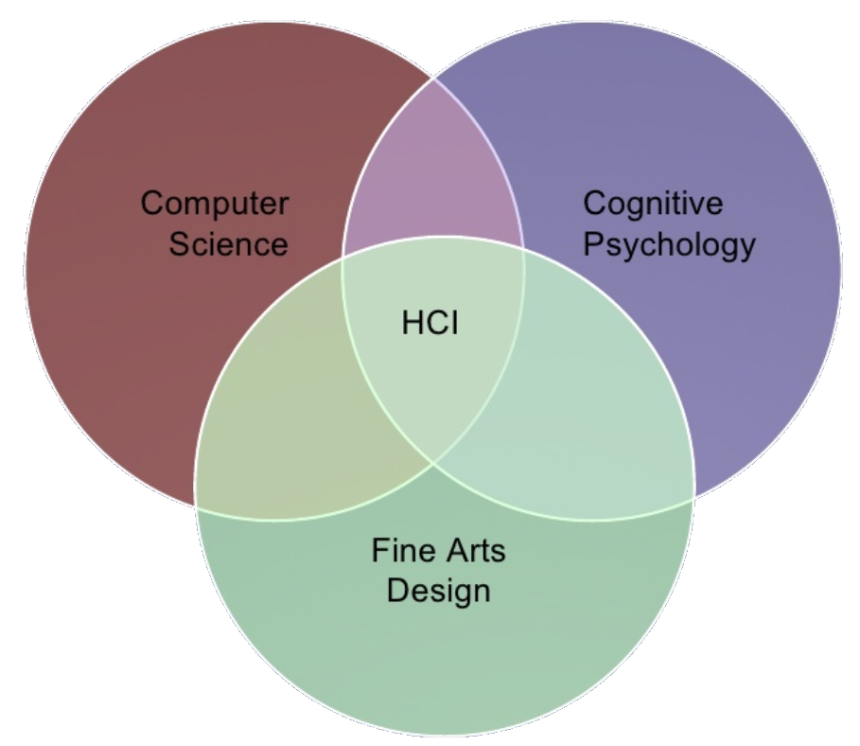
The Intersection of HCI
The intersection of three disciplines (i.e. major fields of study)
  Computer Science
  Cognitive Psychology
  Fine Arts Design
Notes:
HCI is a multidisciplinary field. HCI is at the insertion of three disciplines, which are computer science, cognitive psychology, and fine arts design.

Slide 20
The Intersection of HCI (2)
Computer Science
  Designs the software that interacts with the hardware
Notes:
HCI is a multidisciplinary field. HCI is at the insertion of three disciplines, which are computer science, cognitive psychology, and fine arts design.
Computer science designs the software that interacts with the hardware.

Slide 21
The Intersection of HCI (3)
Cognitive Psychology
  Examines how the
  mind processes information
Notes:
HCI is a multidisciplinary field. HCI is at the insertion of three disciplines, which are computer science, cognitive psychology, and fine arts design.
Computer science designs the software that interacts with the hardware.
Cognitive psychology examines how the mind processes information.

Slide 22
The Intersection of HCI (4)
Fine Arts Design
  Creates the graphical or visual elements that the people use to interface with the device
Notes:
HCI is a multidisciplinary field. HCI is at the insertion of three disciplines, which are computer science, cognitive psychology, and fine arts design.
Computer science designs the software that interacts with the hardware.
Cognitive psychology examines how the mind processes information.
Fine art design creates the graphical or visual elements that the people use to interface with the device.

Slide 23
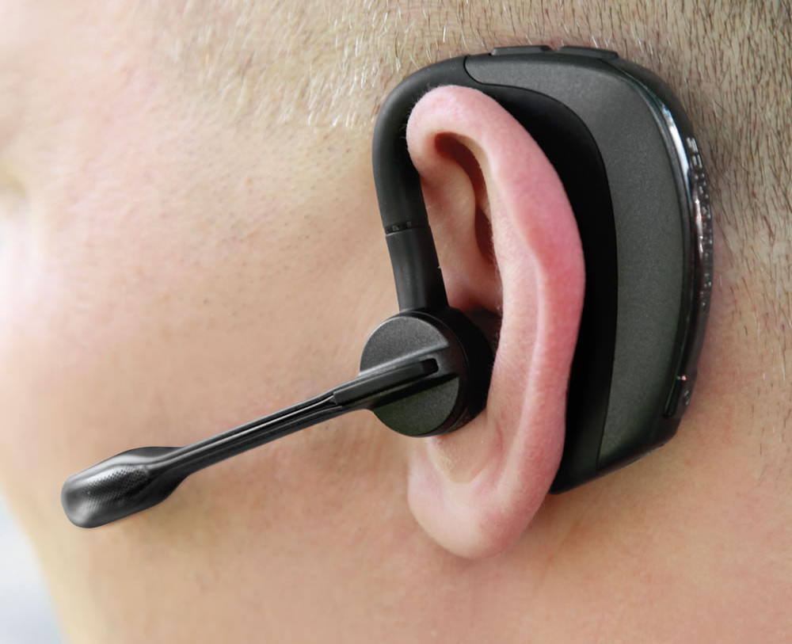
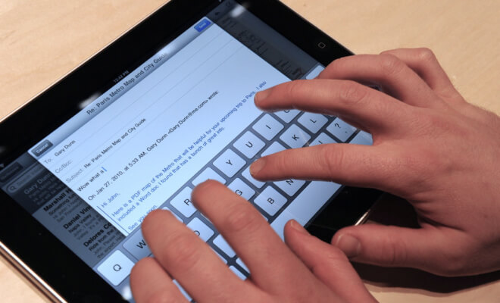
The Intersection of HCI (5)
Physical Interface
Virtual Interface
Notes:
HCI is a multidisciplinary field. HCI is at the insertion of three disciplines, which are computer science, cognitive psychology, and fine arts design.
Computer science designs the software that interacts with the hardware.
Cognitive psychology examines how the mind processes information.
Fine art design creates the graphical or visual elements that the people use to interface with the device.
The visual could be something tangible or real, such as a mouse or headset.
Or, it could be a graphical user interface on an Android phone or Windows computer.

Slide 24

HCI is not about
Not about making the interface look pretty
Not about only desktop computers
Not something that would be nice to
do but usually there’s no time for it
Notes:
HCI does not focus on beautification or adding features to user interfaces. These additions are necessary, but not the job of HCI.

Slide 25
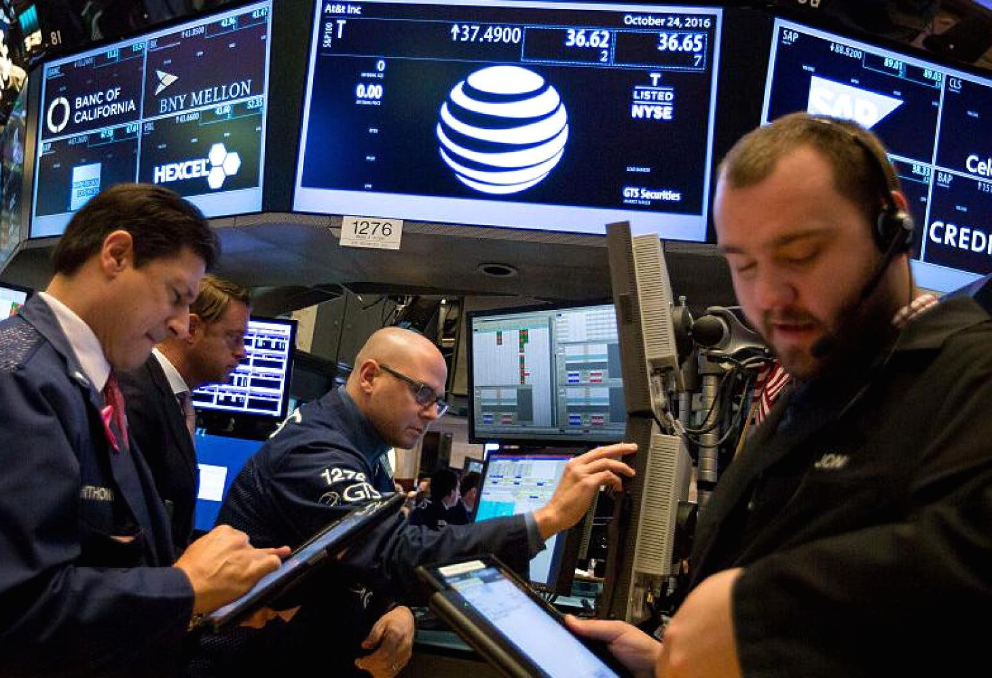
HCI is about
Understanding the
  user
  user’s tasks
  the environment
UI requirements and analysis
Evaluating the system
Notes:
Instead, HCI focuses on understanding the user, their tasks, and their environment.
HCI gathers user interface requirements and analyzes the data to provide users with a better way to interface with the system.
HCI continually evaluates the system to find ways to improve the interaction between it and the user.
For example, a stock trader in the New York Stock Exchange interacts with the system differently than someone reading about financial news.
The data source might be the same, but the environment is entirely different.
HCI seeks ways for these various groups to interact with the same system in ways that benefit each group.

Slide 26
Introduction to HCI Summary
HCI is the interaction between humans and computers
HCI strives to create systems that are easy to learn, easy to use, and error free
The golden rule of HCI is: People should come first
HCI is the at the interaction of three disciplines
  Computer Science, Cognitive Psychology, & Fine Arts Design
Notes:
In summary, we interact with technology every day.
We call this interaction HCI, which is humans interacting with computer systems.
The goal of HCI is to create systems that are easy to learn, easy to use, and error free.
The golden rule of HCI is that people should come first.
Since developers create technology to help people, HCI focuses on improving how humans use computers to accomplish a task.
HCI is at the intersection of three disciplines, which are computer science, cognitive psychology, and fine arts design.
Examples of HCI are a touchscreen on your phone, a mouse connected to a computer, or using voice to write a text message.

Slide 27
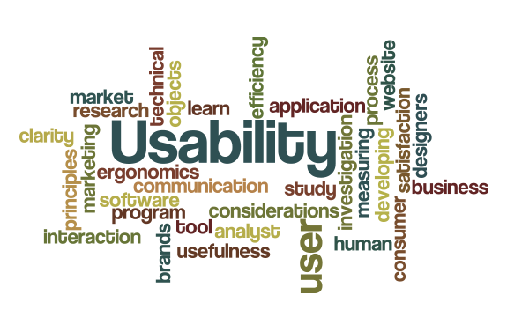
4.2: HCI Goals
4.1: Introduction to HCI
4.2: HCI Goals
4.3: HCI User Experiences
Notes:
Watch on YouTube: https://youtu.be/g6TLAH7zUqg
This section discusses the goals and objectives of HCI.

Slide 28
Objectives
State the goal of HCI
Describe usability
Explain why usability is important
Show examples of difficult-to-use systems
Notes:
Please take a moment to read the learning objectives for this video.

Slide 29

What is the goal of HCI?
The goal of HCI is to improve the interaction between users and computer by making computers more user-friendly and receptive to the user’s needs
Notes:
The goal of HCI is to improve the interaction between users and computers by making computers more user-friendly and receptive to the users’ needs.

Slide 30
What is the goal of HCI? (2)
In other words:
  Make technology easy to use
  Create usable systems
Notes:
In other words, HCI seeks to make technology easy to use, which it does by creating usable systems.

Slide 31
What is usability?
A usable system is
  Intuitive - Quick and easy to learn
  Efficient to use
  Easy to remember how to use
  Allows rapid recovery from errors
Notes:
What is a usable system?
Firstly, it is a system that is intuitive, which is quick and easy to learn.
For example, a user can operate a new device to accomplish some task by following the system prompts.
The user does not need to resort to a complicated instruction manual.
Secondly, the system is efficient to use.
The user can accomplish the task using little effort.
For example, withdrawing money from an ATM or paying a bill through a terminal.
Thirdly, the system is easy to remember how to use.
Once someone uses the system, they can then easily use it again with minimal effort.
Finally, a usable system is one that crashes infrequently and recovers quickly from errors.
The user probably causes the errors, but the system can quickly return the user to a point where they can try again.
For example, the system asks for a phone number, but the user omits the country code. Does the system crash, or inform the user to enter the data again?

Slide 32

Why is usability important?
Creates satisfied users who
  Use the system to accomplish a task
  Become loyal customers
Notes:
Usability is of extreme importance to the user and the company that maintains the system.
Users don’t say they like using a system if it works well, but users hate poorly designed systems.
People will use systems that can easily accomplish their desired task. Satisfied users become loyal customers.

Slide 33

Why is usability important? (2)
Most users have a choice
  Users will seek a system they can use
Notes:
Most users have a choice of which system they will use.
For example, which cell service will they use? Which bank will they use? Companies need loyal customers to support their business.

Slide 34

Why is usability important? (3)
Returning users
  Loyalty and user trust
  Without users, the system
  will not be used
Notes:
HCI is about more than just interfacing with a computer.
The computer becomes the interface between the customer and the business.

Slide 35
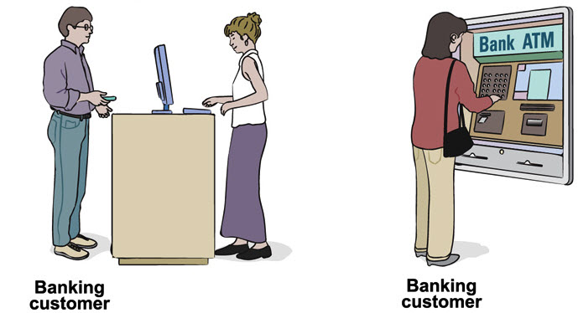
Why is usability important? (4)
Computer becomes the interface between the customer and business
Notes:
HCI is about more than just interfacing with a computer.
The computer becomes the interface between the customer and the business.
Banks provide ATMs so their customers can withdraw money from their accounts without going to see a bank teller.

Slide 36
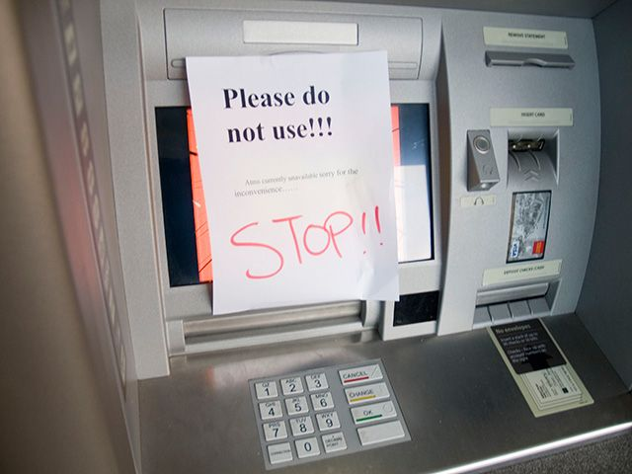
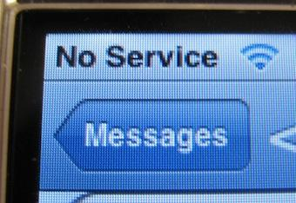
Why is usability important? (5)
Notes:
What if a user could not reliably get money from the bank’s ATMs? Or, if the debit card only worked at certain stores? That bank would not have satisfied or loyal customers.
How about if your mobile was frequently out of cell range? Would you stay with spotty coverage, or switch to a different carrier? In other words, companies lose business if they do not have satisfied customers.

Slide 37
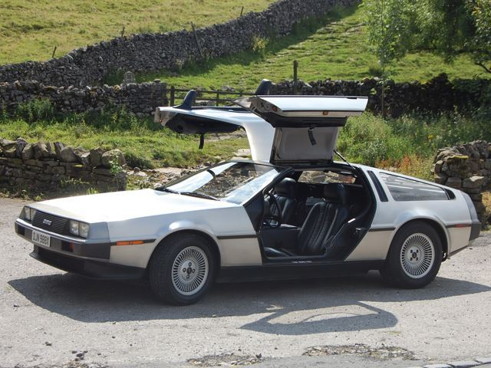
Why is usability important? (6)
Besides in Back to the Future, how many cars have you seen with doors like that?
A good experiment, but not easy to use
Notes:
Have you ever ridden in a car with doors that open up, instead of out? I’m guessing you haven’t. This experimental design proved not to be practical.

Slide 38

Difficult-to-use systems
Are annoying, embarrassing, frustrating, and even deadly
Notes:
HCI strives to create easy-to-use systems.
Systems that are difficult to use or poorly designed are annoying and cause frustration or embarrassment.
What if you want to send a message to your friends saying you will be late, but you get a network error because you are in an area with limited coverage?
In some cases, a system failure or wrong input can cause injury or death.
What if a medical system fails at a hospital or the nurse is confused about which button to press?

Slide 39
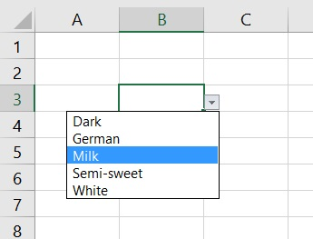
Difficult-to-use systems (2)
Are annoying, embarrassing, frustrating, and even deadly
Increase mistakes in data entry and system operation
Item | Color (r/b/bl/g) | Size (s/m/l)
T-shirt | r | M
T-shirt | Blue | La
Socks | gr | x
Notes:
Poorly-designed systems increase mistakes in data entry or system operation.
For example, a user is taking inventory, but there are no clear guidelines for the product code. Is the code ‘b’ for blue, black, or brown?
The user entered a value ‘x’ in the size column, which is an invalid entry.
A better option is to give the user a drop-down menu that contains the possible values.

Slide 40
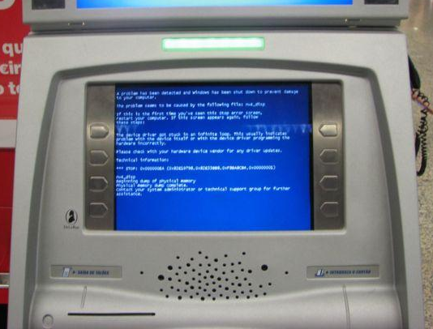
Difficult-to-use systems (3)
Are annoying, embarrassing, frustrating, and even deadly
Increase mistakes in data entry and system operation
Cause system failure
Notes:
Difficult-to-use or poorly-designed systems can cause system failure.
If a user enters an unexpected value, the system could crash.
Perhaps the system was expecting a phone number without the dashes, and a user entered the dashes. How should it respond?

Slide 41
HCI Goals Summary
The goal of HCI is to create usable computer systems
A usable system is easy to learn and use, and recovers rapidly from errors
Users like systems that they can use
Users avoid difficult to use systems
Notes:
The goal of HCI is to improve the interaction between users and systems by making computers more user-friendly and receptive to the user’s needs.
In other words, HCI seeks to make technology easy to use, which it does by creating usable systems.
A usable system is one that is quick and easy to learn, efficient to use, easy to remember how to use, and allows rapid recovery from errors.
Given a choice, people will use systems that can easily accomplish their desired task.
Satisfied users become loyal customers.
Companies need loyal customers to support their business.
Difficult-to-use or poorly-designed systems are annoying and cause frustration.
They increase errors in data entry and operating the system. Finally, poor design can cause a system to crash or cease to function.

Slide 42
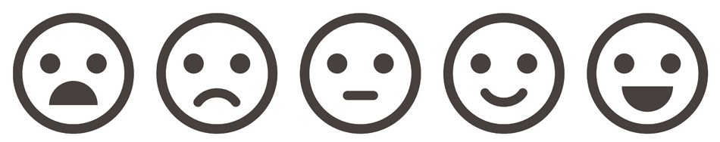
4.3: HCI User Experiences
4.1: Introduction to HCI
4.2: HCI Goals
4.3: HCI User Experiences
Notes:
Watch on YouTube: https://youtu.be/Bo4MbwUvJhY
This section examines many different negative examples of user experiences or design flaws.

Slide 43
Objectives
Notice how users want to use systems
List examples of obstacles that prevent usability
Think of how these systems could be improved
Notes:
Please take a moment to read the learning objectives for this video.

Slide 44
Recall HCI’s goals
The golden rule in HCI is that people should come first
HCI Goals
  Make technology easy to learn and use
  Create usable systems
  Allows rapid recovery from errors
Notes:
To recap, the golden rule in HCI is that people should come first.
The goals of HCI are to make technology easy to learn and use, create usable systems, and allow rapid recovery from errors.

Slide 45
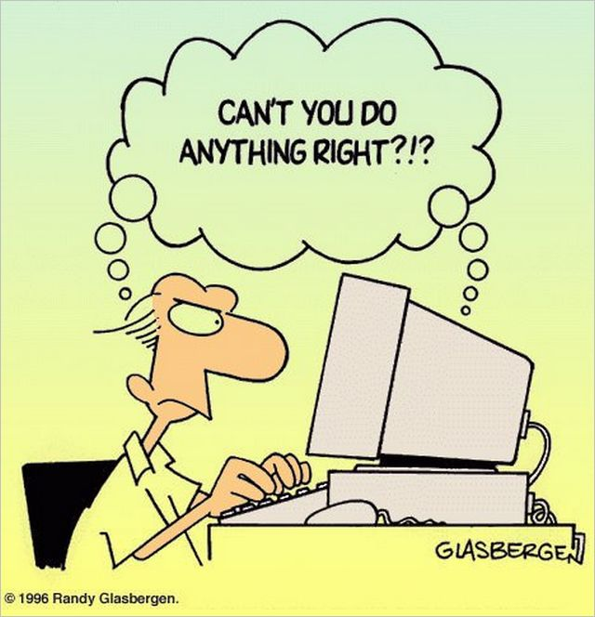
The unpleasant experiences
Designers can have specific requirements how they want others to use their software
However, users do not always agree
Notes:
There are many reasons why developers create systems that users loathe or strongly dislike.
Developers can have specific requirements of how they want others to use their software.
However, users do not always agree with the developers.
Some of the developer's criteria are necessary, such as banking systems requiring strong passwords.
Other times, developers should listen to their users.

Slide 46
The unpleasant experiences (2)
Recall this image?
This website is about the designer, not the user
  Users can access my site if they do so under my requirements, which are…
Notes:
Do you recall this image? The developer has an agenda that they want the users to follow.
This issue is about the display of information, nothing essential.
This designer neglected the golden rule and thought that a user should only view the website the way the developer wants it to be viewed.
What if the user does not have access to a laptop?

Slide 47
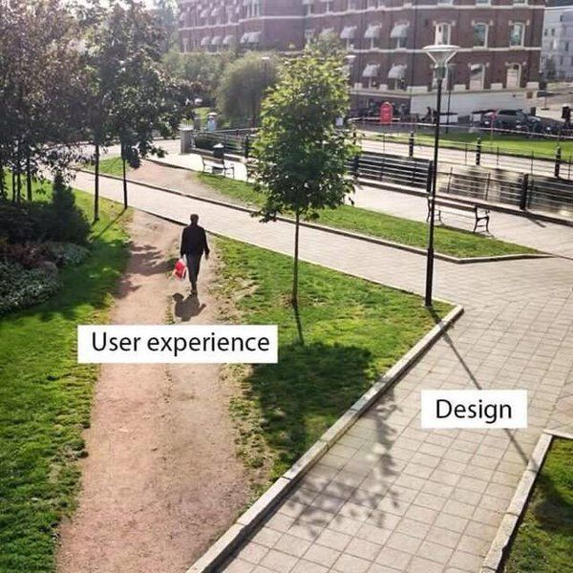
The easy path
Users take the path of least resistance
Designers and users do not always agree
Notes:
Users take the path of least resistance. Just like with the phone in the previous slide, designers and users do not always agree. Users have ideas that developers didn’t consider at the time.

Slide 48
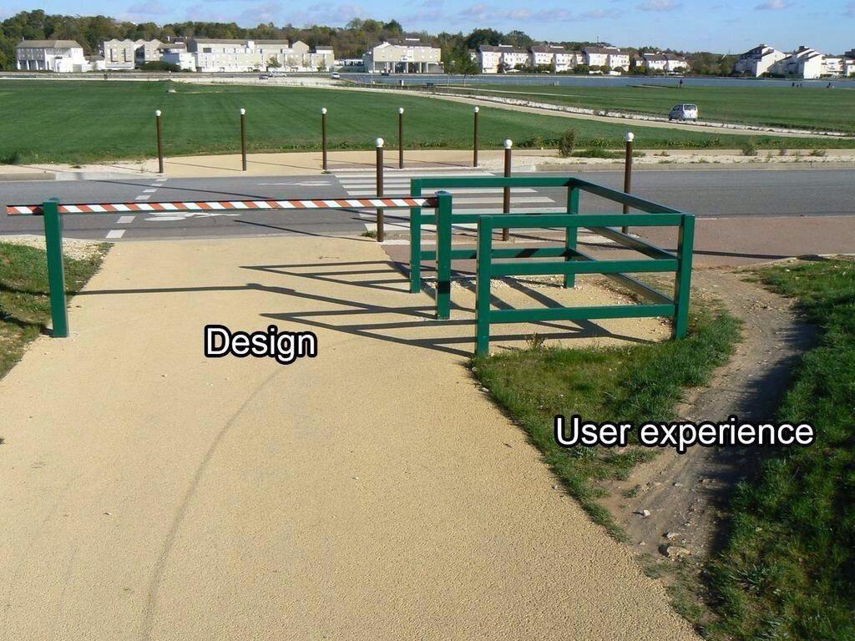
Users break rules
Users don’t always follow the rules
They find a way around barriers they do not agree with
Notes:
Users will break the rules of the system given a chance. They will find a way around the barriers that they do not agree with. This designer wants to keep bicyclists out of the park, but the park rangers lack a method of enforcing the rule.

Slide 49
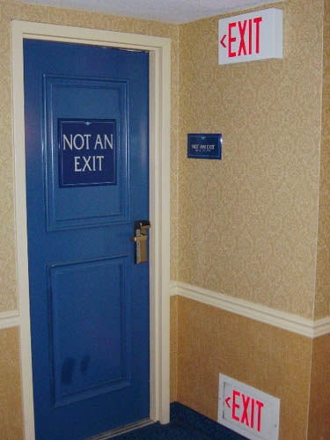
HCI wants to avoid…
Impossible circumstances
Notes:
The study of HCI is important to avoid impossible circumstances.
These users followed the exit signs but came to a dead end due to a design change.

Slide 50
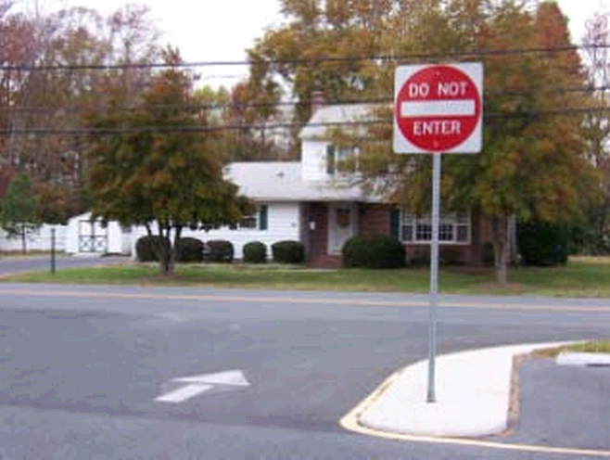
HCI wants to avoid
Impossible circumstances
Conflicting messages
Notes:
The study of HCI is important to avoid impossible circumstances.
These users followed the exit signs but came to a dead end due to a design change.
HCI wants to avoid conflicting messages. One indicator says proceed, but another one says stop.

Slide 51
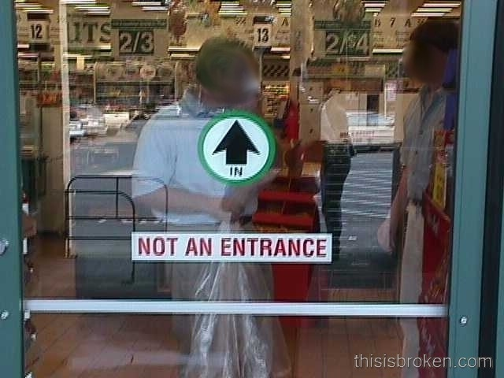
HCI wants to avoid
Impossible circumstances
Conflicting messages
Contradictory labels
Notes:
The study of HCI is important to avoid impossible circumstances.
These users followed the exit signs but came to a dead end due to a design change.
HCI wants to avoid conflicting messages. One indicator says proceed, but another one says stop.
Here is another example of contradictory labeling, which leaves the shopper to wonder if they should enter, or search for another door.

Slide 52
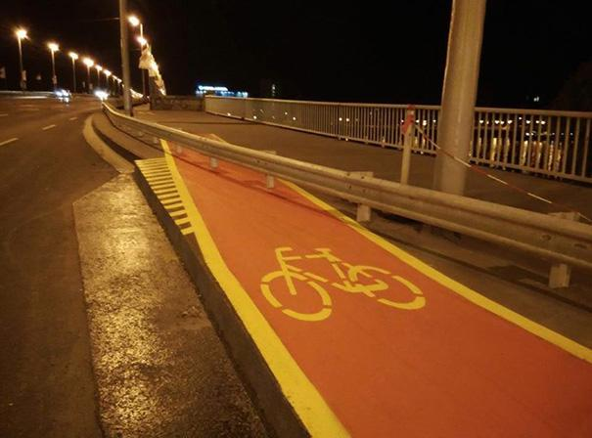
HCI wants to avoid
Impossible circumstances
Conflicting messages
Contradictory labels
Paths that lead to obstacles
Notes:
The study of HCI is important to avoid impossible circumstances.
These users followed the exit signs but came to a dead end due to a design change.
HCI wants to avoid conflicting messages. One indicator says proceed, but another one says stop.
Here is another example of contradictory labeling, which leaves the shopper to wonder if they should enter, or search for another door.
HCI wants to avoid paths that lead to obstacles. The guardrail was put up for safety, but it did not accommodate the bikers. They now face an obstacle that they have to overcome.

Slide 53
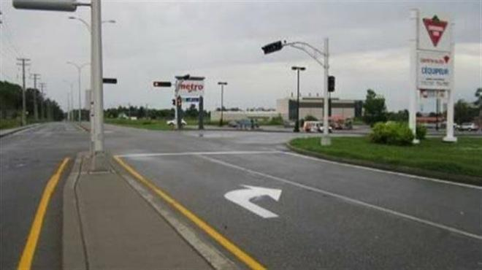
HCI wants to avoid obvious mistakes
The painters had the template the wrong way
Notes:
HCI should avoid obvious mistakes.
This painter had the template upside down. Oops.

Slide 54
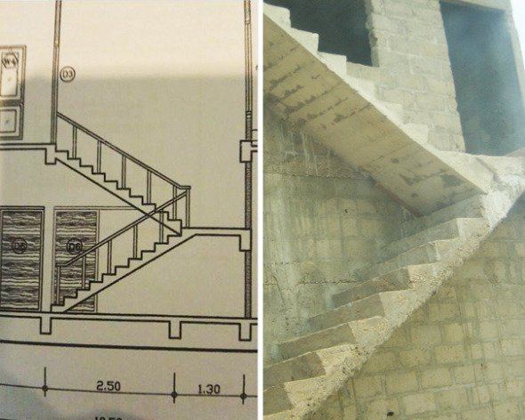
HCI wants to avoid (2)
Construction workers built the staircase according to one view of the picture
Notes:
HCI should avoid obvious mistakes.
This painter had the template upside down. Oops.
This construction worker built the staircase according to one view of the picture. This action is negligence, not a simple mistake.

Slide 55

Importance of consistency
Familiarity
The accepted norm
Placement of button
Alignment of the physical
and virtual elements
Notes:
Consistency is an important aspect of HCI since it helps to create easy-to-use systems.
Designers should create consistent user interfaces because users become familiar with doing things one way, which becomes the accepted norm.
Examples of consistency are the button's placement and the color of Accept and Cancel.

Slide 56
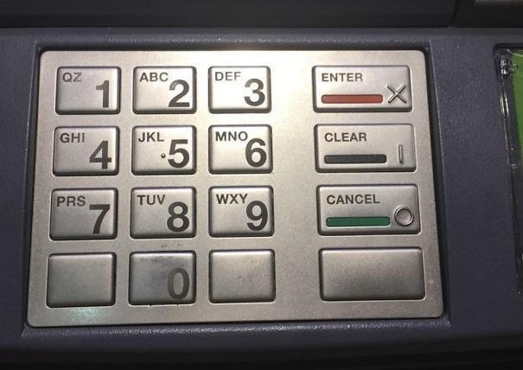
Quality control fail
Red = Cancel
X = Cancel
Enter = Accept
Which buttons do you press?
Do you use text or the color and braille symbol?
Notes:
This keypad has a labeling defect. It is unknown to the user which button is Accept and which is Cancel until they press one. However, a user familiar with ATM keypads can figure out the labeling error and successfully use the system. This mistake is a labeling issues. The text Enter and Cancel are incorrect. The colors, X, and O are in the correct positions.

Slide 57
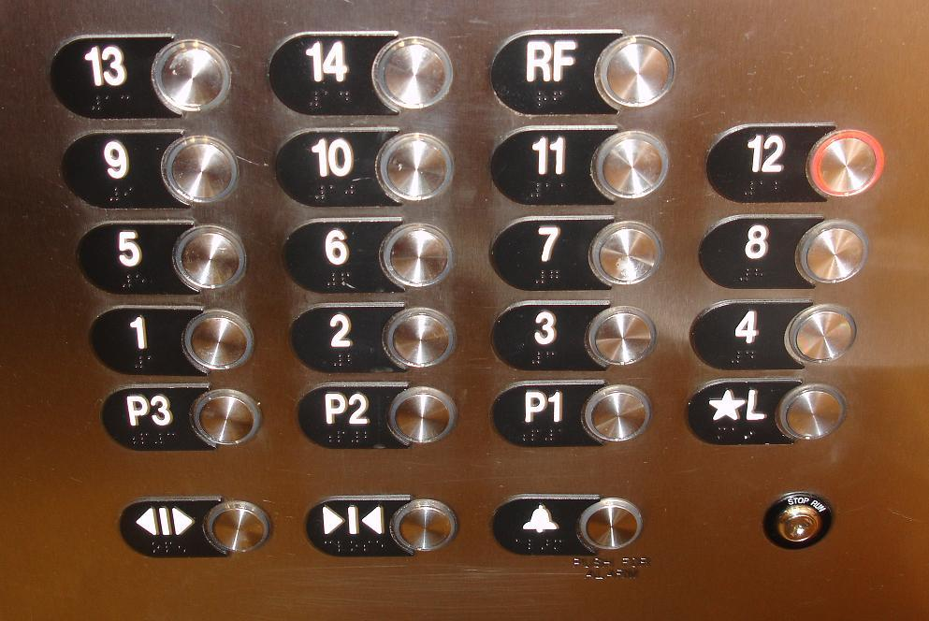
Vertical vs Horizontal
How many people press 5 when want to go the second floor?
Notes:
How many people press 5 when wanting to go to the second floor?
These elevator buttons are aligned horizontally, not vertically. The typical alignment is vertical.

Slide 58
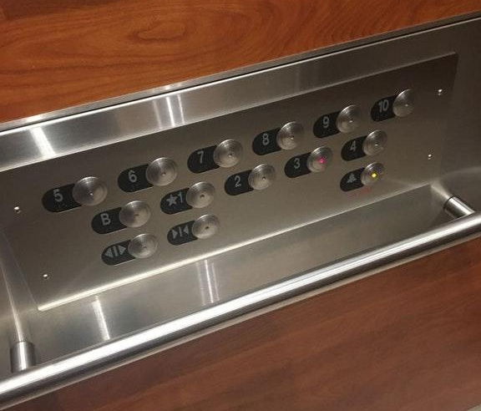
Vertical vs Horizontal
A better solution for horizontal alignment
Offset the vertical alignment so users know what way to read
Notes:
How many people press 5 when wanting to go to the second floor?
These elevator buttons are aligned horizontally, not vertically. The typical alignment is vertical.
However, there are reasons for breaking consistency, such as to accommodate those in a wheelchair.
In this case, the designers offset the vertical alignment to add clarity to the panel.

Slide 59
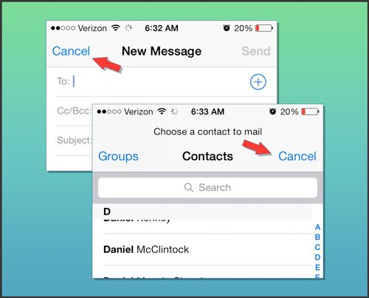
Change of Cancel button placement
Existing users will be pressing the cancel button when they want to send the message
Notes:
In this example, the designers changed the position of the cancel button from the left side to the right side.
The users who were accustomed to pressing the send button without thinking, will now instead press the cancel button.

Slide 60
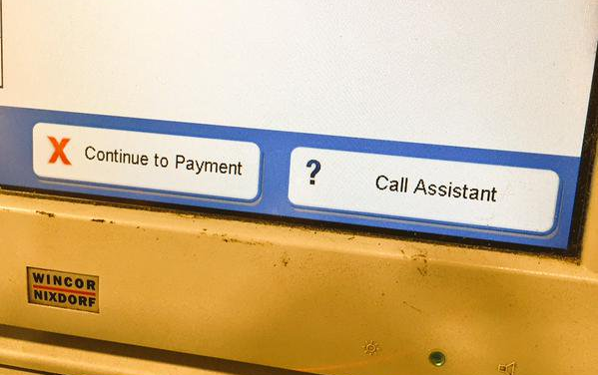
Unconventional practices
The red X is reserved for an error
The position of the button with the red X is the usual position for the Cancel button
Notes:
Colors and symbols have importance in HCIs.
Red and the X are reserved for the negative, whereas green and the O are reserved for good or accept.
This unconventional practice in this image will cause the user to stop and think before they press the button.
Will the button allow them to continue, or will it cancel the operation?

Slide 61
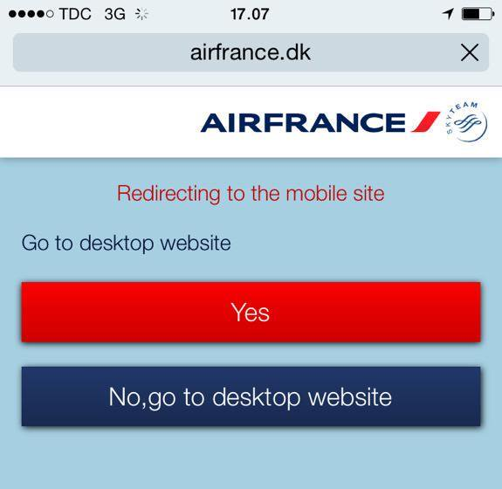
Unconventional practices
Red is commonly used to indicate an error or cancel
Notes:
Colors and symbols have importance in HCIs.
Red and the X are reserved for the negative, whereas green and the O are reserved for good or accept.
This unconventional practice in this image will cause the user to stop and think before they press the button.
Will the button allow them to continue, or will it cancel the operation?
Similarly, this website uses a red button for yes or accept.

Slide 62
Simple error handling
Errors are unavoidable
Users will use the system in unexpected ways
Developers should plan for the unexpected and gracefully fail, and then recover if possible
Notes:
Another important design consideration in HCI is simple error handling. Developers know that errors are unavoidable. The users will use the system in unexpected ways. Developers should plan for the unexpected and gracefully fail, and then recover if possible.

Slide 63
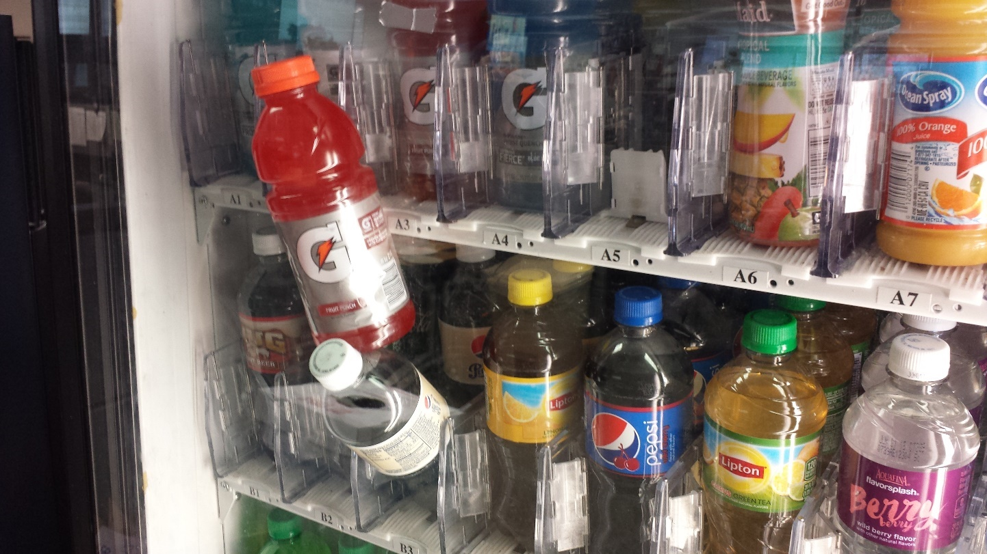
No reboot option
Notes:
Not all systems can recover by themselves.
This vending machine has a design flaw that the developers did not consider.
Perhaps they should have made the lower shelves shorter than the upper ones to avoid collisions.
The user has to pay more money and hope they get both bottles, or wait for the snack technician to return and refund the thirsty user.

Slide 64
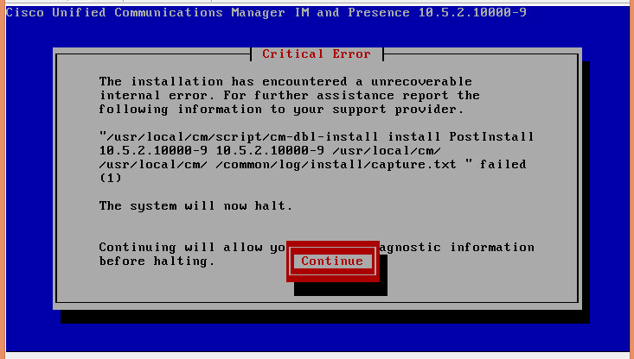
Unrecoverable system error
Notes:
A system might enter a state of an unrecoverable system error. Cases such as these could be a result of hardware failure. Hopefully, these situations rarely occur.

Slide 65
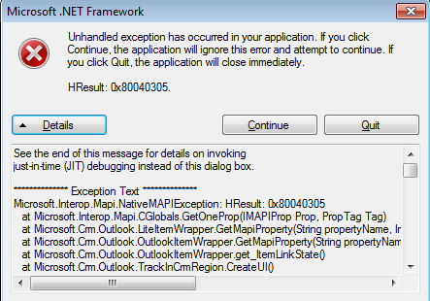
Messages for developers
Unhelpful text
Developers needs to see this, not users
How do you handle this?
Notes:
Some poorly-designed systems show error messages that are meant for the developers.
These type of error reports are unhelpful to the end users.
If you see a message like this, what do you do?
You would probably press the red X in the upper-right corner hoping that the box goes away.
In this case, the user should not be presented with the option to forcefully exit the application by pressing the quit button, unless it is the last option.

Slide 66
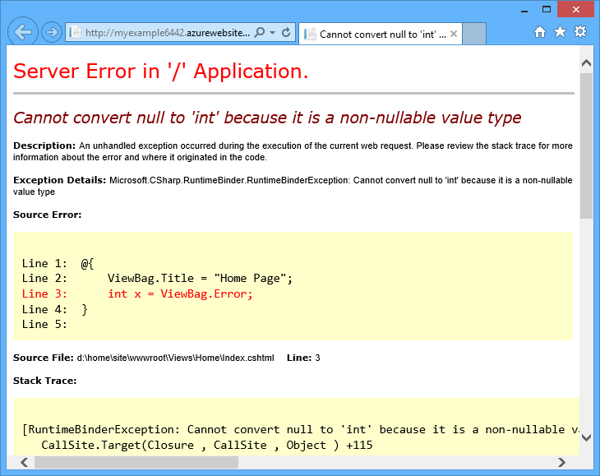
Messages for developers (2)
Have you visited a webpage and see an ASP error page instead?
A user should not see this error message
Notes:
Have you visited a webpage and seen an ASP error page instead?
A user should not see these types of error messages.

Slide 67
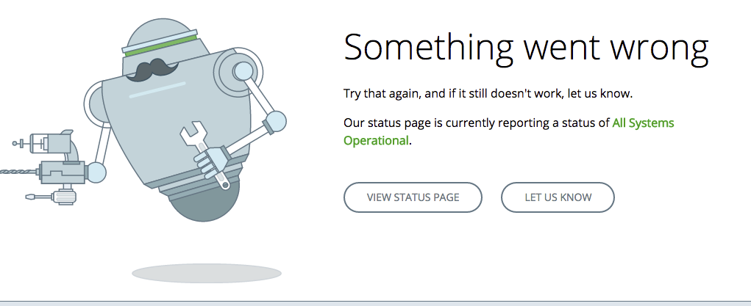
A better error message
Notes:
Have you visited a webpage and seen an ASP error page instead?
A user should not see these types of error messages.
Instead, a better error message provides instructions to the user on how to proceed.

Slide 68
Create usable systems
A usable system is:
  Quick and easy to learn
  Efficient to use
  Easy to remember how to use
  Allows rapid recovery from errors
Notes:
Let’s take a look at some difficult-to-use or confusing systems. Just to recap, a usable system is one that is easy to use.

Slide 69
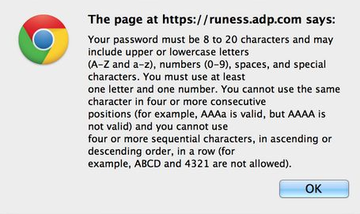
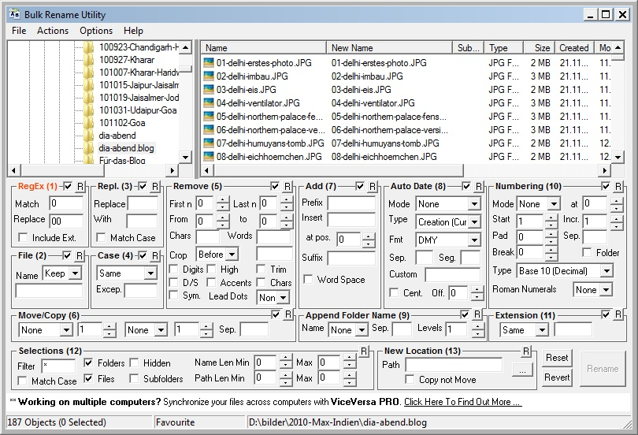
Overly complex requirements
Difficult Password Requirements
Busy User Interface
Notes:
Neither of these examples takes into consideration the user’s best interest.
While it is good to enforce strong passwords, there becomes a point where it no longer provides a benefit, or it causes a negative effect.
Either the user will give up and find another website, or they will write the password down.
The next example shows all of the possible options in the application to the user, rendering it unusable.
The user needs to see a basic set of features to accomplish the task. Features are great, but developers can hide them in a settings page for the power users.

Slide 70
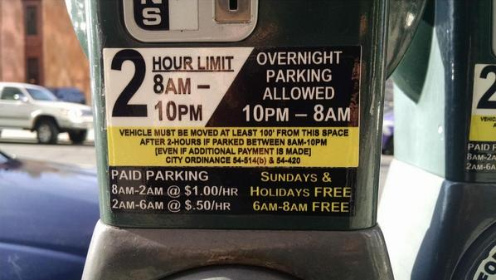
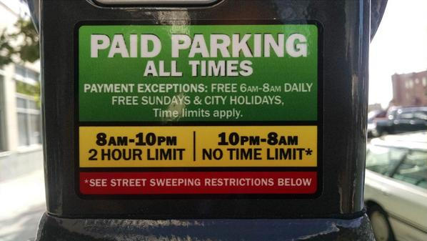
Simplification
Old Instructions
New Instructions
Notes:
Simplification can help users accomplish their task.
The parking meter on the left side resulted in frustrating users since they were getting ticketed. It wasn’t clear when they could or could not park in that space.
Creating a new label helped the users understand when they needed to pay.

Slide 71
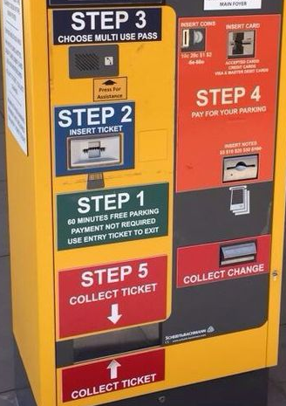
Lacks logical flow
This parking meter does not have linear process flow
Users of the Latin and Cyrillic alphabets naturally read upper-left to lower-right
Notes:
How would you like to use this parking meter?
It lacks a logical flow of top to bottom, which is how readers of the Latin and Cyrillic alphabets would approach the machine.
We would want to start in Step 3, but then realize that we can’t.

Slide 72

Not user friendly
This parking meter was so confusing that someone had to tape on printouts.
Notes:
This parking meter was so confusing that someone had to tape on printouts to help the users.
If you notice, the payment arrow points to the screen above instead of to the card reader to the left.
Users can figure out these machines, of course, but it takes cognitive effort and time to process the misguided information.

Slide 73

Not user friendly (2)
This parking meter was so confusing that someone had to tape on printouts.
Notice the payment arrow points to the screen
Notes:
This parking meter was so confusing that someone had to tape on printouts to help the users.
If you notice, the payment arrow points to the screen above instead of to the card reader to the left.
Users can figure out these machines, of course, but it takes cognitive effort and time to process the misguided information.

Slide 74

Which is which?
What are the button pairs?
Is the right square going to take you up or down?
Notes:
This elevator panel leaves the user wondering which button will take them up or down. Which are the button pairs? Is the right square going to take you up or down? There is only one way to find out...

Slide 75

Reversal of action
This operation prevented the user from undoing the previous changes
Notes:
Finally, a usable system should have a back button or an undo option.
Users commonly enter invalid data.
A system should expect this and provide a way to undo the data entry error, such as an edit field for already submitted data or a back button to fix the incorrect value.
Users do not like filling in a form only to find out they missed something and have to retype the data.

Slide 76
User Experiences Summary
Systems are created to help people
However, users face many obstacles due to system requirements
  Avoidable and unavoidable
HCI strives to create ways for people to use the systems that easy
Notes:
In summary, systems are created to help people or they replace jobs once held by humans.
For example, a driver puts money into a parking meter instead of paying an attendant.
However, users face many obstacles due to system requirements.
Some of these are real requirements and unavoidable, but other ones are not necessary, and therefore avoidable.
HCI strives to create ways for people to use systems in ways that are easy.
These usable systems should be easy to learn, easy to use, and free of errors.

